Slide 1
Today’s Topics (Chapter 10 and 11)
Tracing recursive functions (chapter 9)
Organizing programs (chapter 10)
Local variables vs. Global(External) variables (chapter 10)
Scope of variables (chapter 10)
Introduction to Pointers (chapter 11)

Slide 2
Trace a recursive function
Example:
int f(int num){
if(num==1 || num ==2 ){
return 1;
}
else
return f(num -1)+ f(num-2);
}
What is f(5)?

Slide 3
Fibonacci numbers
Fibonacci numbers: 1, 1, 2, 3, 5, 8, 13, 21, 34, 55,…
A recursive function that computes the Fibonacci number F(n) defined by the formula
F(n) = F(n-1) + F(n-2), for n>=3.
with initial values F(1) = 1, F(2) = 1, for n = 1, 2

Slide 4
Exercise
What is fun1(2, 3)?
int fun1(int x, int y)
{
if(x == 0)
return y;
else
return fun1(x - 1, x + y);
}
A) 5
B) 6
C) 3
D) None of the above

Slide 5
Organizing a C Program

Slide 6
Organizing a C Program
Major elements of a C program:
Preprocessing directives such as #include and #define
Declarations of external variables
Function prototypes (declarations)
Function definitions

Slide 7
Organizing a C Program
There are several ways to organize a program so that these rules are obeyed.
One possible ordering:
#include directives
#define directives
Declarations of external variables
Prototypes for functions other than main
Definition of main
Definitions of other functions

Slide 8
Organizing a C Program
It’s a good idea to have a boxed comment preceding each function definition.
Information to include in the comment:
Name of the function
Purpose of the function
Meaning of each parameter
Description of return value (if any)
Description of side effects (such as modifying external variables)

Slide 9
Local Variables

Slide 10
Local variables
Local variable storage(automatic storage duration)
Storage (memory) is “automatically” allocated when the enclosing function is called
and deallocated when the function returns.
Local variable scope (block scope) – Where it is visible
A local variable is visible from its point of declaration to the end of the enclosing function body.

Slide 11
sum_digits.c
#include <stdio.h>
int sum_digits(int n);
int main(void)
{
int num = 987;
printf("the sum of the digits is %d\n", sum_digits(num));
return 0;
}
int sum_digits(int n)
{
int sum = 0; /* local variable */
while (n > 0) {
sum += n % 10;
n /= 10;
}
return sum;
}
11

Slide 12
Parameters
Parameters have the same properties—automatic storage duration and block scope—as local variables.
Each parameter is initialized automatically when a function is called (by being assigned the value of the corresponding argument).

Slide 13
sum_digits.c
#include <stdio.h>
int sum_digits(int n);
int main(void)
{
int num = 987;
printf("the sum of the digits is %d\n", sum_digits(num));
return 0;
}
int sum_digits(int n)
{
int sum = 0; /* local variable */
while (n > 0) {
sum += n % 10;
n /= 10;
}
return sum;
}
13

Slide 14
External (Global) Variable

Slide 15
External Variables
Passing arguments is one way to transmit information to a function.
Functions can also communicate through external variables—variables that are declared outside the body of any function.
External variables are sometimes known as global variables.

Slide 16
External (Global) Variables
Properties of external variables:
Static storage duration: has a permanent storage location, it retains its value throughout the execution of the program
File scope: having file scope means that an external variable is visible from its point of declaration to the end of the enclosing file.
16

Slide 17
storage.c
What is the output of this program?
#include <stdio.h>
void fn();
int main()
{
int i;
printf ("Program storage starting\n");
for (i = 0; i < 5; i++)
{
fn();
}
printf ("Normal termination\n");
return 0;
}
void fn()
{
int counter = 0;
counter++;
printf ("This function has been called %d times\n", counter);
}

Slide 18
A Global Variable
#include <stdio.h>
int counter = 0; //counter is a external (global) variable
void fn();
int main()
{
int i;
printf ("Program storage starting\n");
for (i = 0; i < 5; i++)
{
fn();
}
printf ("The function was called %d times\n", counter);
printf ("Normal termination\n");
return 0;
}
void fn()
{
counter++;
printf ("This function has been called %d times\n", counter);
}

Slide 19
Pros and Cons of External Variables
External variables are convenient when many functions must share a variable, but
In most cases, it’s better for functions to communicate through parameters rather than by sharing variables:
Functions that rely on external variables are hard to reuse in other programs.
If an external variable is assigned an incorrect value, it may be difficult to identify the guilty function.

Slide 20
Pros and Cons of External Variables
Making variables external when they should be local can lead to some rather frustrating bugs.
Code that is supposed to display a 10 × 10 arrangement of asterisks:
int i;
void print_one_row(void)
{
for (i = 1; i <= 10; i++)
printf("*");
}
void print_all_rows(void)
{
for (i = 1; i <= 10; i++) {
print_one_row();
printf("\n");
}
}
What’s wrong with the code?

Slide 21
Variable i should be local variables
void print_one_row(void)
{
int i;
for (i = 1; i <= 10; i++)
printf("*");
}
void print_all_rows(void)
{
int i;
for (i = 1; i <= 10; i++) {
print_one_row();
printf("\n");
}
}

Slide 22
Block
Local variables have block scope – the scope doesn’t extend beyond the function to which it belongs, other functions can use the same name for other purposes.
Block:
{ declarations statements }
By default, the storage duration of a variable declared in a block is automatic: storage for the variable is allocated when the block is entered and deallocated when the block is exited.

Slide 23
Blocks
Example of a block:
if (i > j) {
/* swap values of i and j */
int temp = i;
i = j;
j = temp;
}
temp is a local variable and has block scope
23

Slide 24
Scope
In a C program, the same identifier may have several different meanings.
The most important scope rule: When a declaration inside a block names an identifier that’s already visible, the new declaration temporarily “hides” the old one, and the identifier takes on a new meaning.
At the end of the block, the identifier regains its old meaning.

Slide 25
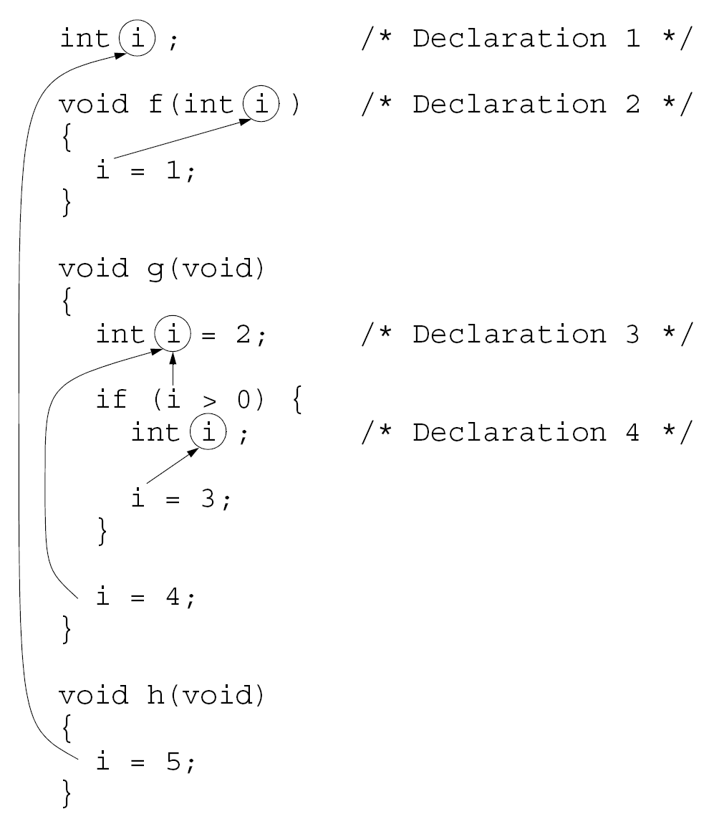

Slide 26
Scope
In the previous example, the identifier i has four different meanings:
In Declaration 1, i is a variable with static storage duration and file scope.
In Declaration 2, i is a parameter with block scope.
In Declaration 3, i is an automatic variable with block scope.
In Declaration 4, i is also automatic and has block scope.
C’s scope rules allow us to determine the meaning of i each time it’s used (indicated by arrows).

Slide 27
Exercise
6 2 2 2
6 3 2 3
2 3 2 3
2 2 2 2
None of the above
What is the output?
int b=0, c =2;
int main(void){
int b = 2;
c++;
f();
printf(“%d %d\n”, b, c);
}
void f(void){
int b = 5;
b++;
printf(“%d %d ”, b, c);
}

Slide 28
Pointers

Slide 29
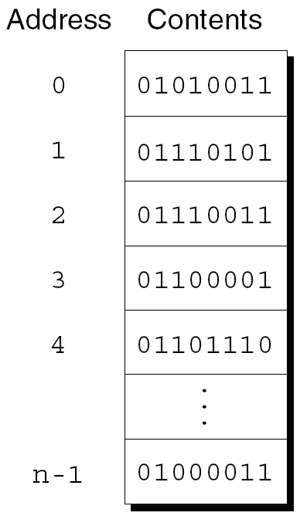
Pointer Variables
Each byte in main memory has a unique address.
If there are n bytes in memory, we can think of addresses as numbers that range from 0 to n – 1:
Main Memory

Slide 30
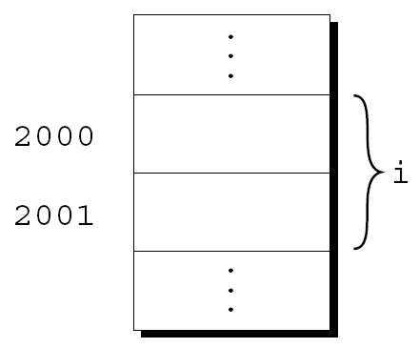
Pointer Variables
Each variable in a program occupies one or more bytes of memory.
The address of the first byte is said to be the address of the variable.
For example, the address of the variable i is 2000:

Slide 31

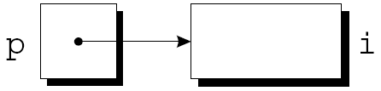
Pointer Variables
Addresses can be stored in special pointer variables.
When we store the address of a variable i in the pointer variable p, we say that p “points to” i.
A graphical representation:

Slide 32
Declaring Pointer Variables
When a pointer variable is declared, its name must be preceded by an asterisk:
int *p;
p is a pointer variable capable of pointing to integers.

Slide 33
Declaring Pointer Variables
Pointer variables can appear in declarations along with other variables:
int i, j, *p, *q;
To avoid confusion, use separate lines for pointer variables:
int i, j;
int *p;
int *q;

Slide 34
Declaring Pointer Variables
C requires that every pointer variable point only to objects of a particular type (the referenced type):
int *p; /* points only to integers */
double *q; /* points only to doubles */
char *r; /* points only to characters */
There are no restrictions on what the referenced type may be.

Slide 35
Display Pointer Values
To print the value of a pointer, or address of a variable, call printf function with %p conversion specification:
int *p;
printf(“%p”, p);

Slide 36
The Address Operator &
Declaring a pointer variable sets aside space for a pointer but doesn’t make it point to an object:
int *p; /* points nowhere in particular */
It’s crucial to initialize p before we use it.

Slide 37
The Address and Indirection Operators
C provides a pair of operators designed specifically for use with pointers.
To find the address of a variable, we use the & (address) operator.
To gain access to the object that a pointer points to, we use the * (indirection) operator.

Slide 38
The Address Operator &
One way to initialize a pointer variable is to assign it the address of a variable:
int i;
int *p;
i = 5;
p = &i;
Assigning the address of i to the variable p makes p point to i.

Slide 39
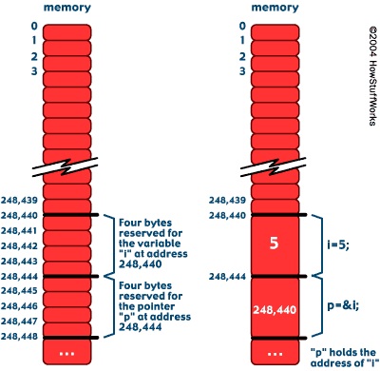

Slide 40
The Indirection Operator
To gain access to the object that a pointer points to, we use the * (indirection) operator.
If p points to i, *p is an alias for i.
*p has the same value as i.
Changing the value of *p changes the value of i.

Slide 41
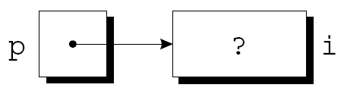
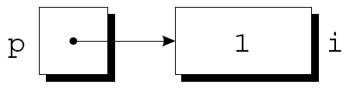
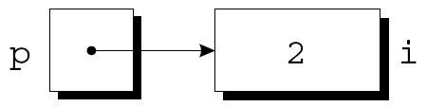
The Indirection Operator
int i;
int *p;
p = &i;
i = 1;
printf("%d\n", i); /* prints 1 */
printf("%d\n", *p); /* prints 1 */
*p = 2;
printf("%d\n", i); /* prints 2 */
printf("%d\n", *p); /* prints 2 */

Slide 42
Exercise
i is int and p and q are pointers to int,
Which assignment is illegal?
A) p = &i;
B) p = *&q;
C) p = i;

Slide 43
Programming Exercise, Part 1
Write a program that declare pointer variables p and q to integer type.
Declares an integer variable i, initialize to 4.
Declares an integer variable j, initialize to 6.
Assign p by the address of i, and q by the address of j
Display the values of i and *p.
Display the values of &i and p, use %p as the conversion specification.
Change the value of i to 32 by using *p
Display the values of i and p.
Assign p with q, display the value of i, j, *p, *q

Slide 44
Programming Exercise, Part 2
Add statements to the program that declares an int array a with 4 elements 5, 8, 2, 9.
Display the memory address of each element using & and %p.

